Slide 1
CSCI 201
Final Project Presentation
<Office Hours>
Hudson-Han Nguyen
Jacob Cashman
John Meyering
Catherine Su
Denny Shen
Joseph Lee
Notes:
Hello CS201 grader, I’m Hudson, I’m Jacob, I’m John, I’m Catherine, I’m Denny, and I’m Joseph, and together we developed a web game titled “Office Hours.”

Slide 2
Game Overview
Office Hours mimics the game Diner Dash, where the user plays as a USC CP to assist students with their CS assignments.
CP’s are given 3 strikes (complaints from the students) before being fired!
Unlimited rounds that progressively get more difficult!
More students need the CP’s help
Students get more impatient each round
Leaderboard to compare scores between players
Notes:
Hudson: Office Hours is a remake of the classic game, Diner Dash, where instead of playing as a waitress in a bustling restaurant, you play as a CP at USC helping out desperate CS students in SAL finish their assignments. Your goal as CP is to get as far as possible in the game, as represented through your score and the amount of rounds you complete. The game is over when you lose all three of your lives, and each life is lost when a student loses their patience over waiting on you, the player, and leaves SAL. The game gets progressively more difficult per round, where you have more students to serve, and each of them grow more impatient per round, but this all contributes to the competitive aspect of the game where each user’s score is submitted and the top 5 can be viewed on the actively updated leaderboard.

Slide 3
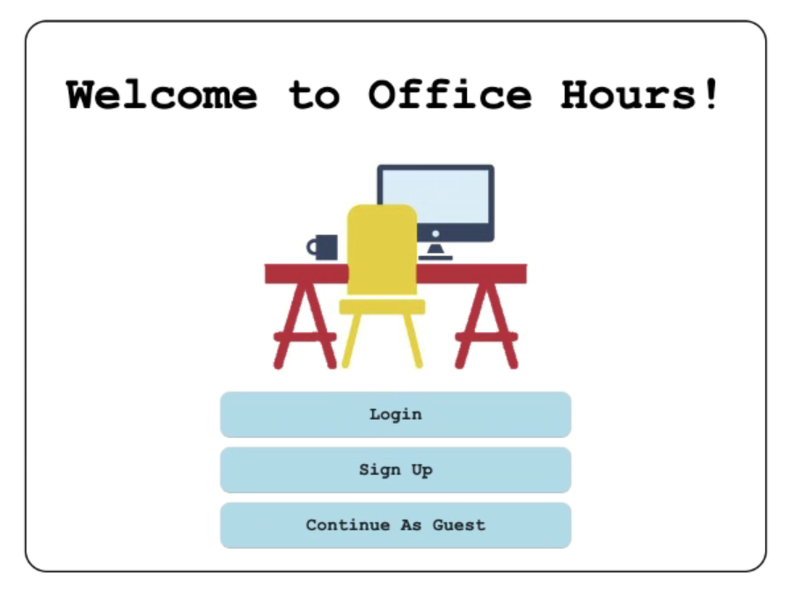
User Login Functionality
Both the authenticated users and guests will be able to play the game; however, only the authenticated users will have their scores saved within the database
Notes:
Hudson: In terms of user login functionality, there are two ways that users may choose to play the game. They may sign up for an account and login, from which their score will be recorded and submitted to the leaderboards, or they may play as a guest, from which they can play the game like normal, but their score will not be saved.

Slide 4








Skills and Tools
Eclipse
GitHub
Visual Studio Code
Sublime Text
MySQL Workbench
Tomcat
Photoshop
Notes:
JOSEPH: Within our project, our group members used a variety of skills and tools to create this game. One of the tools that we used was Eclipse. Eclipse was the main tool that we used for

Slide 5
Continuing Professional Development
Frame-by-frame Javascript Game Development
State Machine
JavaScript Class Inheritance
HTML Canvas via JavaScript
HTML Modal
Bootstrap
JQuery
Notes:
John
Because our project was both web-based and a game, our team had a lot of room for professional development.
To go point by point:
(1)First off, because we had to make a game and Adobe Flash is dead- We needed to learn how to get a frame-by-frame environment working in Javascript
(2)Point number 2- In order to maximize our games modularity, we modeled the rounds of the game like a state machine. We had a starting state that would initialize our students, our computers, everything we needed to get going with a round. We had a “during round” state that would tell our user’s machine to update all of those computers and students we made in the starting state. We had a “between rounds” state that would keep us in limbo between rounds until the user was ready to go on to the next. And we had a “game over” state for when we wrapping up and wanted to move on the the game over screen. So state machines helped immensely in organizing our code.
(3)As for point number 3, you might think that classes and inheritance are trivial at this point, but in javascript, until a few years ago, classes didn’t exist and everything was a function. Because of that fact, all of the code we adapted from the internet was outdated and needed refactoring.
(4)Then for point number 4, it was necessary that we displayed our graphics on a canvas in the HTML, both for the game and the leaderboard.
(5)Point number 5, the HTML Modal was used in our “between rounds” phase to give the user a breather and let them proceed when they are ready.
(6)Point number 6, we used bootstrap to streamline and standardize the user interface
(7) and similarly, we used JQuery to streamline our JavaScript

Slide 6
Design and Development Decisions
What Worked: What Didn’t:
Tasks distribution: 3 game; 2 database; 1 main menu
We were able to put our work together in the end through GitHub
Communicated well to put all the separate parts together
Everyone in the group worked very hard
Some of the game features were not implemented due to the time limit (extra CP).
Conflicting schedules meant it was difficult for everyone to meet up at the same time
Due to the many planned features and conflicting schedules, it was sometimes hard to get everyone on the same page
Notes:
John
Taking a look back at our design and development:
A lot of pivotal decisions turned out well-
()Our guess that 3 people working on the game, 2 people working on the database, and 1 person working on the main menu left everybody with a job that was modular and sizeable
()therefore allowing us to take advantage of GitHub branches to the full extent
()Merging things back together was a snap and everyone put in a good effort
But some things didn’t work so well:
()We ran out of time and couldn’t implement two player-controlled CP’s
()Because everybody got shifted geographically due to COVID, it was hard to get meetings together
()And then at the start of our coding phase it was hard to start working because there were just so many features, where would each of us begin? But, with some communication we got that worked out

Slide 7
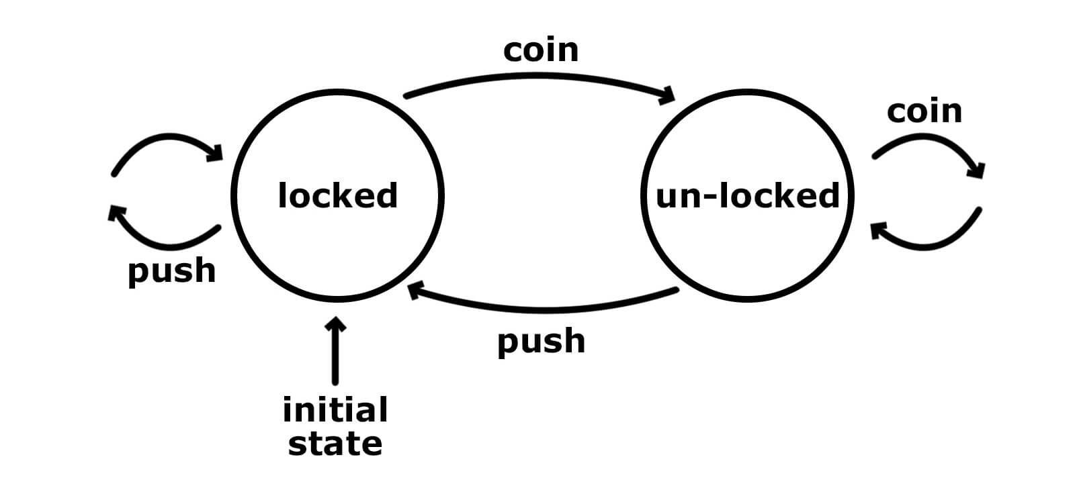
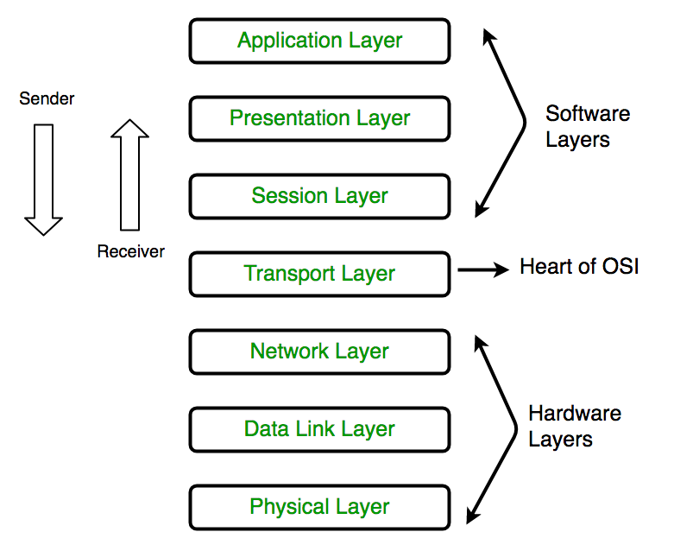
Outside Courses
Class Inheritance from CSCI 104
State Machine from EE 109
The Game Loop from ITP 380
Modern Web Development (JQuery) from ITP 303
Transport Layer Socket Programming from EE 250
Notes:
Denny:
We also mixed in concepts from other classes outside 201 to build our game.
From CSCI 104, we were familiarized with creating superclass and its subclasses. Since the game is written in JavaScript, we used constructor functions to mimic an object-oriented design pattern in JavaScript.
From EE 109, we were taught about the state machine, and we had the game in three states being starting, between, and during states.
From ITP 380, game loop concept was introduced that we need to have an overall flow control of the entire game. We have the game runs at 50 FPS as the screen refreshes every 20 milliseconds.
From ITP 303, we had JQuery taught in depth for simplier HTML javascript methods calls.
From EE 250, socket programming was explained under the Transport Layer, we used it for server client communication on some ports.
All these extra techniques from other classes made our OFFICE HOUR game possible.

Slide 8
Data Structures
Actor and classes that inherit from Actor (CP, Computer, etc.) (User defined)
Array (JavaScript built-in)
Queue (used to hold students)
Vector (used in broadcaster.java)
JSON
Notes:
Catherine: For Data Structures, we created an actor base class that all the character such as cps, students, chairs and computers inherited from. We created arrays to hold all the computers and chairs to update them all during the game loop. We made a queue of students that decreased when they sat in a chair. The class broadcaster.java
has a vector of serverThreads, holding each servlet waiting for a new leaderboard. JSON was used in send the leaderboard to the client.

Slide 9
Networking
‘broadcaster’
MySQL Database
Socket Connection
User Authentication
Servlets were used for database queries
JSPs were used to carry user information from page to page
Leaderboard updated
Servlet requests to add new scores in database & retrieve leaderboard
Socket connection to send leaderboard to all servlets
Servlets/JSPs
Servlet sends HTML to client
Clients
Notes:
Jacob
We actually used two forms of networking in this project, the main way being the servlets and JSPs which were used for user authentication as well as providing the visual pages for the client to display. Additionally, we used a socket connection which helped update the leaderboard in real time.

Slide 10
MultiThreading
Servlet opens socket with broadcaster file, notifies it that database has been updated
Sends score to servlet POST request (receives game over screen as response)
End-game Client
(adding a new score to the database)
‘broadcaster.java’
(has a vector of serverThreads, representing each servlet waiting for a new leaderboard)
‘newScore’ Servlet
Broadcaster sends leaderboard to servlet over socket connection
Servlet sends leaderboard to client as a JSON
When client receives the leaderboard as a response, it displays it and immediately makes a new request
In-game Client
(looking to update leaderboard)
‘GetLB’ Servlet
When broadcaster is notified a new score has been added, it retrieves the new updated leaderboard from the database as a Leaderboard object
Socket connection established between Servlet and leaderboard broadcaster
Makes AJAX request to retrieve Leaderboard
Notes:
Jacob
Originally, we had the clients continually making AJAX requests to a servlet, which would then query the database, retrieve the current leaderboard, and send it as a JSON.
We wanted a way to display the current leaderboard without constantly needing to make AJAX requests and Database queries every few seconds.
So without going into too much detail, we basically came up with a program that runs alongside the Tomcat server meaning on a different port, is notified when the database has been updated, and sends the leaderboard to every client that is waiting on a response.
This way, the database would only be need to be queried when it was updated, and after being queried once, the leaderboard would be distributed to every client waiting on the new leaderboard.
This solved a problem having so many AJAX requests and database queries which would arise in a situation where there were many users at once, and was also an interesting way to implement multithreading.

Slide 11
Thank You! Or something...

